Slide 1
Introduction to the Perspectives of Psychology

Slide 2
What is PSYCHOLOGY?
Psychology is the scientific study of mind and behavior.
Behavior is what can be observed from outside.
Mind refers to our thoughts, feelings, private sensations, and various internal processes.
Let’s look at the history of psychology to understand how it became defined as it is today.
Psi is the official symbol of psychology.
Notes:
It is the penultimate letter of the Greek alphabet, psi, which is the first letter of the Greek term psyche (or, more accurately, "psuche").

Slide 3
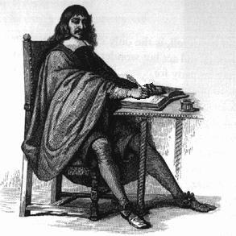
History of Psychology
Socrates (450 BC)
“The mind is separate from the body. Also, we are born with all knowledge. We learn nothing that we did not already have in our mind at birth.”
When did psychology originate?
You could say we’ve always wondered...“Who am I?” and “Who are you?”
Ex. Trephination (6500 BC)
Most early philosophers had opinions on the relationship between thought and behavior
“Knowledge is power. And the only way to gain knowledge is to study things through the scientific method.”
Bacon (1600 AD)
Plato (400 BC)
Aristotle (350 BC)
“Teach, I love you but you’re wrong. The soul and body are one. And, we learn everything after birth through experience.”
“I am a dualist like Socrates.”
Notes:
Bullet 1
And why do I behave and think as I do, and why are you different?
Trephining...Archaeologists and historians have found. Pic from museum of anthropology in Lima, Peru.
400 BC
Socrates
-The mind is separate from the body
-Knowledge is innate
Plato had similar opinions as Socrates. However, his pupil Aristotle differed.
Aristotle
-Soul and body are one
-Learn from experiences
2000 Years Later (1600s)
René Descartes
-Dualism
Francis Bacon
- Baconian Method
-”Knowledge is Power”
John Locke
-Mind is a “tabula rasa”
-empiricism begins

Slide 4
History of Psychology
The various theorists and theories in psychology’s history can be organized into distinct “waves” (or schools of thought).
Wave One - Introspection
Wave Two - Gestalt Psychology
Wave Three - Psychoanalysis
Wave Four - Behaviorism
Wave Five - Multiple Perspectives
Notes:
Each wave being a way of thinking about human thought and behavior that dominated the field for a certain period of time.

Slide 5
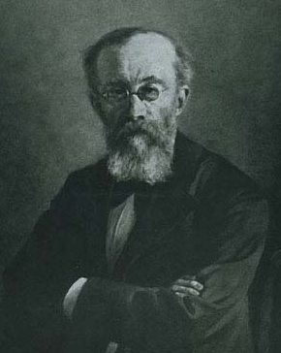
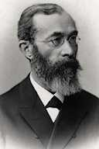
Wave One - Introspection
Most psychologists date the beginning of scientific psychology to the year 1879 with...
Wilhelm Wundt (1832-1920)
In 1879, Wundt set up the first psychological laboratory in Leipzig, Germany
Wundt trained subjects in introspection
Subjects were asked to record accurately their cognitive reactions to simple stimuli
Wundt focused on breaking down mental processes into the most basic components
Wundt eventually called his theory structuralism, which became the first school of thought in psychology.
Notes:
Strengths of Structuralism
Structuralism is important because it is the first major school of thought in psychology.
Structuralism also influenced experimental psychology.
Criticisms of Structuralism
By today’s scientific standards, the experimental methods used to study the structures of the mind were too subjective—the use of introspection led to a lack of reliability in results.
Other critics argue that structuralism was too concerned with internal behavior, which is not directly observable and cannot be accurately measured.

Slide 6
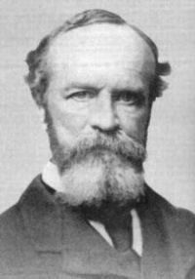
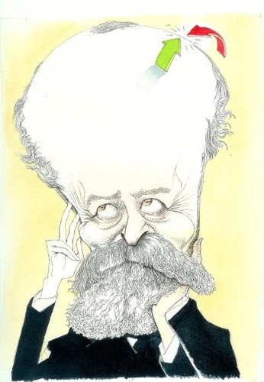
Wave One - Introspection
William James (1842-1910)
James reacted to structuralism by advocating the second school of thought known as functionalism
examined how mental activities assist us in adapting to our environment.
In 1890, James published The Principles of Psychology, the science of psychology’s first textbook.
These introspective theories were important in establishing the science of psychology, but they do not significantly influence current psychological thinking.
Notes:
Functionalism used a lot of Darwin’s evolutionary ideas.

Slide 7
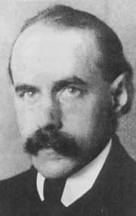
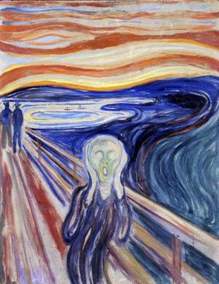
Wave Two - Gestalt Psychology
Max Wertheimer (1880-1943) is the father of the Gestalt perspective.
Wertheimer argued against dividing human thought and behavior into discrete structures.
It would be like trying to understand a painting in terms of each and every brushstroke. Impossible.
The Gestalt (organized whole) approach holds that the whole is more than the sum of its parts.

Slide 8
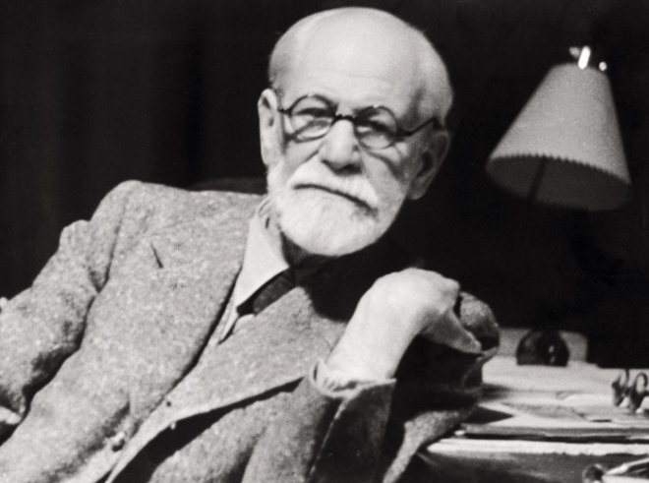
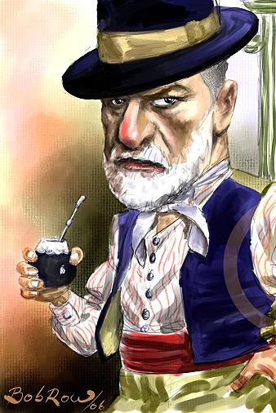
Wave Three- Psychoanalysis
Sigmund Freud (1856-1939) is the father of psychoanalytic theory which revolutionized psychology.
While working with patients, Freud believed he discovered the unconscious mind
Part of our mind, which we are unaware of and over which we have no conscious control, that guides how we think and behave
Our unconscious mind builds up over the years through repression
We push anxious/tense events and feelings into our unconscious so that we don’t have to deal with them consciously.

Slide 9
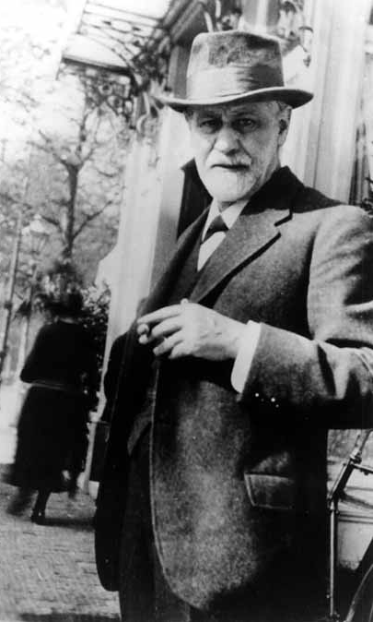
Wave Three- Psychoanalysis
How do psychologists study our unconscious?
Dream Analysis
Word Association
Other psychoanalytic techniques
Many therapists still use Freud’s techniques today and his influence on psychology (and beyond) cannot be overstated.
Freud’s theories have many critics as well? Why?
Notes:
Dream analysis
According to Freud, we learn through fairy tales, myths, jokes, folklore, poems and linguistic usage. These same symbols are used in our dreams. The patient recalls their dreams that can often be recurring and traumatic. These are 'the royal road to the unconscious' and with interpretation can indicate areas of trouble that need to be investigated by the patient and therapist. There is a need for interpretation as each symbol is heavily disguised. Although Freud did not explore the cross-cultural differences in the significance of dreams, modern practitioners of this method accept the need for flexibility in interpretation.
Word Association
The patient is invited to say the first word that enters their mind when the therapist gives a stimulus word. This enables unconscious thoughts to enter the conscious ready for investigation later on in the therapy.
Free Association
The patient is invited to talk freely about any topic and subject that they feel comfortable with. The therapist prompts when necessary whilst listening carefully. Over a long period of time the patient will uncover some of the important traumas within their unconscious, therefore making them conscious and accessible for interpretation.
Hypnosis
The patient is placed into a trance. The therapist then investigates the patient's unconscious while it is uncovered in this state. This brings unconscious thoughts and desires out of the unconscious ready for investigation as the patient wakes from their trancelike state.
Projective tests
Here the patient is shown a series of images that are usually abstract, for example ink blots. They are then invited to explain what they see or create a story based on the images. Freud believed that this allows the patient's unconscious to become conscious, unlocking inner thoughts and desires allowing further investigation through further therapy. Hermann Rorschach developed the infamous Rorschach blot test in 1921 and although there are arguments over whether he intended it to be used for projective psychoanalysis, it remains in use today. The ten specially-designed ink blot images used in the Rorschach test are still kept secret to non-practitioners and information about the interpretation methods of this test procedure is also rarely disseminated. Practitioners believe that this could interfere with the clinical and scientific use of the Rorschach test. The random inkblot generator below is an interesting way to explore the use of projective tests, but is not a Rorschach example.

Slide 10
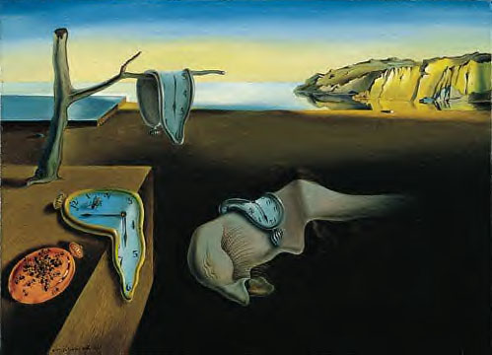
Freud’s Influence on the Arts
Notes:
Freud influenced many surrealist artists, such as Salvador Dali (time painting).

Slide 11
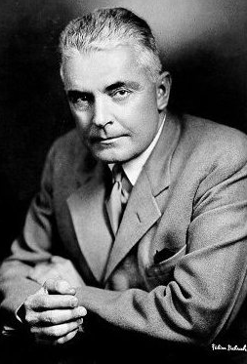
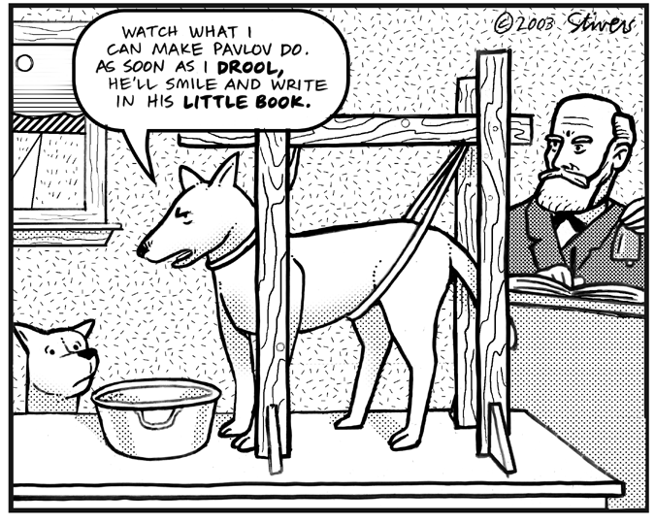
Wave Four - Behaviorism
Watson
John Watson (1878-1958)
Studied the conditioning experiments of Ivan Pavlov.
Watson believed that for psychology to be considered a science, it needed to only study what can be observed.
Watson thought untestable theories, like Freud’s unconscious mind and Wundt’s focus on consciousness were bunk.
Watson and his followers wanted behaviorism to be the dominant standard of psychology.
Notes:
We’ll explain pavolv in more detail later.
Behaviorists maintain that psychologists should look at only behavior and causes of behavior
We should not be concerned with the internal conscious elements that contribute to behavior

Slide 12
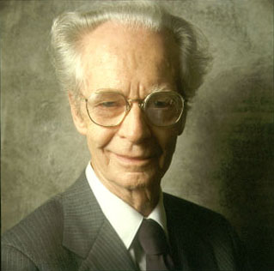
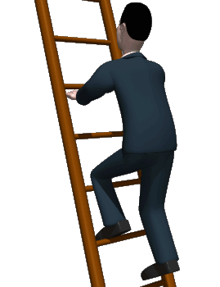
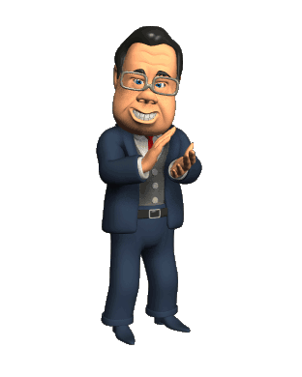
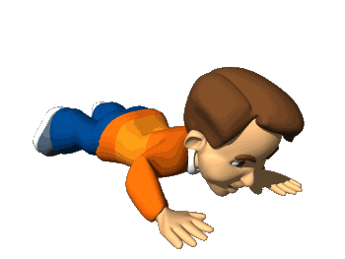
Wave Four - Behaviorism
B.F.Skinner (1904-1990)
Took the ideas of behaviorism to new heights
Skinner studied the power of reinforcement - environmental factors that either encourage or discourage behaviors
Skinner is seen by many as the most influential psychologist of all time!!!
Rewards and Punishments shape our actions throughout our life.

Slide 13
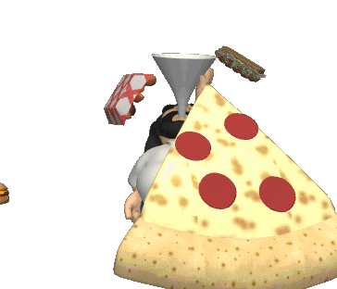
Wave Five - Multiple Perspectives
Today, there is no one way of thinking about human thought and behavior that all or even most psychologists share.
Many psychologists are eclectic - drawing from many perspectives.
Notes:
Like a buffet. Every buffet, from the nicest hotel buffet to the Chinese food buffet at the Red Lion to the lunch buffet at Pizza Hut, all have two components; the type of food served and the type of person eating the food.

Slide 14
Contemporary Perspectives
Let’s look at current major perspectives that psychologists use to examine human thought and behavior (some old perspectives are still prevalent today).
Behavioral
Psychoanalytic
Cognitive
Humanist
Biopsychology (Neuroscience)
Social-Cultural (Sociocultural)
Evolutionary (Darwinian)
How would each of these perspectives look at Stewie’s unquenchable desire to kill his mother?
Notes:
For example, at the lunch buffet at Pizza Hut you have Cheese Lovers pizza, Pepperoni Lovers Pizza, Sausage Lovers Pizza and the ultimate Meat Lovers Pizza. Now the type of person eating the food also makes a difference. I might think the Meat Lovers Pizza is ecstasy on a crust while a vegetarian might look at it as death on pizza doe. So we all have different perspectives on the food at the buffet. AP psychology is no different than the buffet.
The pizzas in AP Psychology are topics like Memory, Sleep, Hypnosis, Drugs, Motivation, Personality, Attraction and a whole bunch more. There are different schools in psychology that look at these topics differently. Just as I love the Meat Lovers Pizza and the vegetarian thinks it putrid, different people in psychology view the topics of psychology in their own ways. These different perspectives are REALLY important and they are known as.......

Slide 15
Behavioral Perspective
Recap from earlier...
1st described by John B. Watson (1913) and later influenced by B.F. Skinner
Behaviorists focus on our OBSERVABLE behaviors
Claims heredity and genetics are not important
If you bit your fingernails when you were nervous, a behaviorist would not focus on calming you down, but rather focus on how to stop you from biting your nails.
If were addicted to video games, how might a behaviorist explain your addiction? How would they try to help you overcome your addiction?
Notes:
Behavioral School: The behavioral school would totally ignore Stewie's feelings or hidden desires. They would just focus on his behaviors that they were able to observe. If Stewie was angry and shot a laser beam at his mother, the behavioral school would only focus on the laser shot and not his feelings. They figure, if they can stop Stewie's behavior (in this case shooting his mother with a laser) then the problem is solved. Who cares about his feelings? They might do something like shock Stewie every time he tries to kill his mom. Stewie would eventually associate the shocking behavior with the idea of killing his mom, and stop his assassination attempts. Again we will tackle all of this in more detail when we study how people learn later on in the year.

Slide 16
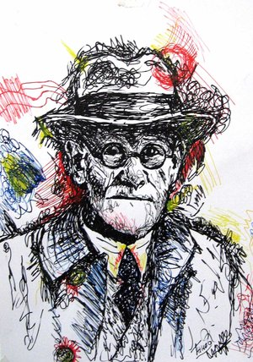
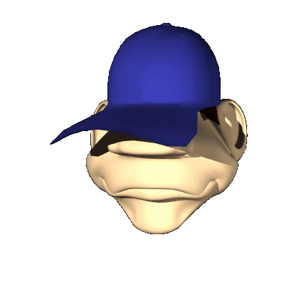
Psychoanalytic Perspective
Recap from earlier...
Developed by Sigmund Freud
Human behavior is primarily determined by unconscious processes that develop during one’s lifetime
Theories are not based on experimental evidence. Many aspects of Freud’s psychoanalytic theory are untestable.
What might a psychoanalyst say is the reason someone always needs to be chewing gum?
Notes:
Psychodynamic School: The psychodynamic school comes from the famous psychologist Sigmund Freud (who will talk all about later). This school postulates (what a great word) that all behavior comes from unconscious drives. The unconscious is that dark hidden place that we all have where all of our secret desires hang out. We are not aware of what is in our unconscious (although through therapy Freud believed he could tell you what was really there), and most of it comes from unresolved conflicts in our childhood. In Stewie's case, a person from the psychodynamic school might say that Stewie actually has sexual feelings for his mother (hidden in the unconscious) and to ignore those feelings, he does the opposite of his true desire (a defense mechanism call reaction formation- but that is for later on in the course) and tries to eradicate her.

Slide 17
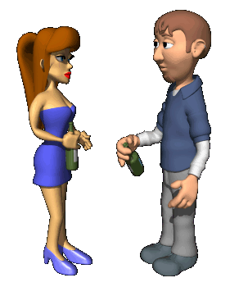
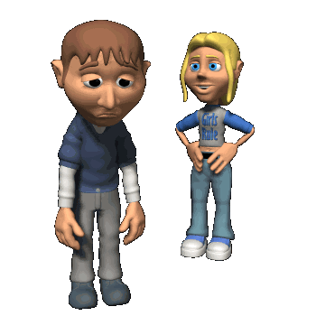
Cognitive Perspective
Cognitive psychologists focus on how we interpret, process, and remember environmental events.
The rules in our mind that we use to view the world are important to understanding why we think and behave as we do.
Promenant figures:
Jean Piaget
Noam Chomsky
Meet girl
Get Rejected by girl
Or get back on the saddle
Did you learn to be depressed
Notes:
Cognitive School: The cognitive school focuses on how we interpret, process and remember events. They would say that Stewie wants to kill his mom because he has learned that that is the best way to deal with the world. We are all cognitive therapists with our best friends. If your best friend just breaks up with their boyfriend or girlfriend and says that their life is over, what will you say? Hopefully, you will say that they will find somebody better and will be happier without the hassle of that dysfunctional relationship. You are attempting to change the way they interpret the world; that is cognitive psychology.

Slide 18
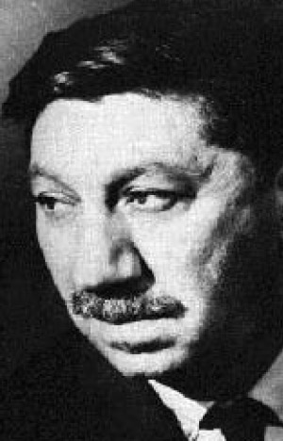
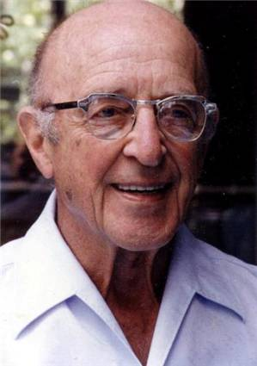
Humanist Perspective
In reaction to the reductionism of behaviorism, humanist psychologists in the 1950s wanted to focus on the mysterious aspects of consciousness again.
They are the feel good hippie psychologists
Abraham Maslow (1908-1970)
Carl Rogers (1902-1987)
Notes:
Abraham Maslow (1908-1970) and Carl Rogers (1902-1987) were influential humanists during its birth as a perspective.

Slide 19
Biopsychology Perspective
Biopsychologists explain human thought and behavior strictly in terms of biological processes.
Human cognition and reactions might be caused by effects of our genes, hormones, and neurotransmitters in the brain or a combo of all three.
If you could not remember the names of your parents and went to a psychologist who adheres to the biological perspective, what might they say?
Notes:
Biological/Neuroscience School: Dudes from this school focus on the brain and body chemistry. They would attribute Stewie's behavior to something physically going wrong with his body. They would look at Stewie's brain for abnormalities, look at his blood chemistry and diet, and maybe put him on drugs to change his behavior.

Slide 20
Social-Cultural Perspective
Social-Cultural psychologists look at how our thoughts and behaviors vary from people living in other cultures.
Our culture plays a huge role in shaping our thought and behavior.
For example, the behavioral norms in one’s culture can be totally different from the norms in another’s culture

Slide 21
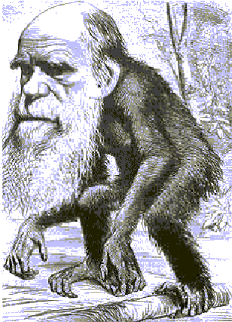
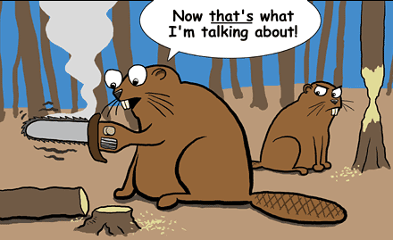
Evolutionary Perspective
Psychologists from this school think all behavior is simply a process of natural selection.
Some psychological traits are beneficial to survival and are passed on from one generation to the next.
Notes:
Evolutionary School: People from this school think all behavior is simply a process of natural selection. Way back in the caveman days, Stewie's great great great great great great great great great great great great grandfather also wanted to kill his mother. For some reason this trait helped Stewie's ancestors to survive and they passed this trait all the way down to Stewie. Think for a second, are you afraid of snakes? Most of you are. Some of our ancestors were and some were not. Those that were not afraid of snakes, saw the pretty snake, went up to pet them and died. Those that had a natural fear of snakes, stayed away from them, lived to have sex, then generations later, you were born.

Slide 22
Contemporary Perspectives
Again, most psychologists today have an eclectic approach to psychology.
These perspectives do not contradict each other, they are simply various ways of looking at psychology.
Cognitive
Behavioral
Humanist
Psychoanalytic
Biopsychology (Neuroscience)
Evolutionary (Darwinian)
Social-Cultural (Sociocultural)
It’s like choosing from a tasty pizza buffet! It’s all good!
Notes:
These perspectives needn’t contradict one another. Rather, they are complementary outlooks on the same biological state. It’s like explaining why grizzly bears hibernate. Is it because hibernation enhanced their ancestors’ survival and reproduction? Because their inner physiology drives them to do so? Because cold environments hinder food gathering during winter? Such perspectives are complementary, because “everything is related to everything else” Finally, if these schools don't make much sense to you, that's OK. All long as you have the basic ideas that there are different ways of looking at the same issues in psychology, I promise you will be fine.
Seriously, the course you are about to spend the next few months on, Advanced Placement Psychology, is a lot like my experiences at the Cici’s buffet. We will be covering scores of different topics in Psychology (about one a week until the end of the semester) touching on every main area there is. The good news is that if you despise a particular topic, the pain will not last long (like eating pizza with anchovies). The bad news is that if you fancy (don't you just love that word) an area (like Canadian bacon and pineapple pizza), you will be forced to move on to the next hurdle in this sprint to the AP Exam. That is the nature of AP Psychology which is modeled after the typical Introduction to Psychology class you would take at any college from Yale University to Omaha College. Every psychology course after the introductory class is simply a more in depth look at a topic you briefly covered in the introductory course. For example, we will spend two weeks learning about psychological disorders, but when you get your butts to college you have the option of taking a semester long class covering those same disorders in more depth. If you actual were able to follow the last few sentences and understand the buffet analogy, this course will be a breeze.

