Slide 1
Lecture 15 & 16
JWD Case II using Scrum Technique
What is Scrum?
Scrum roles, artifacts, Ceremonies
Comparison with other models
Project Pre initiation & Initiation
Planning
Execution
Monitoring & Controlling
Closure
Summary of Chapter # 3

Slide 2
Scrum
  Is an agile, lightweight process
  Can manage and control software and product development
  Uses iterative, incremental practices
  Has a simple implementation
  Increases productivity
  Reduces time to benefits
  Embraces adaptive, empirical systems development
  Is not restricted to software development projects
  Embraces the opposite of the waterfall approach…

Slide 3
Scrum at a Glance
24 hours
Daily Scrum
Meeting
Backlog tasks
expanded
by team
30 days
Sprint Backlog
Potentially Shippable
Product Increment
Product Backlog
As prioritized by Product Owner

Slide 4


Sequential vs. Overlap
Requirements
Design
Code
Test
Rather than doing all of one thing at a time...
...Scrum teams do a little of everything all the time

Slide 5
Scrum Framework
Roles
Product owner
Scrum Master
Team
Ceremonies
Sprint planning
Sprint review
Sprint retrospective
Daily scrum meeting
Artifacts
Product backlog
Sprint backlog
Burndown charts

Slide 6







Scrum Roles
  Product Owner
    Possibly a Product Manager or Project Sponsor
    Decides features, release date, prioritization.
  Scrum Master
    Typically a Project Manager or Team Leader
    Responsible for enacting Scrum values and practices
    Remove impediments / politics, keeps everyone productive
  Project Team
    5-10 members; Teams are self-organizing
    Cross-functional: QA, Programmers, UI Designers, etc.
    Membership should change only between sprints

Slide 7


Sprint Planning Mtg.
Team capacity
Sprint planning meeting
Sprint prioritization
Sprint
goal
Product backlog
Analyze/evaluate product backlog
Select sprint goal
Business conditions
Sprint planning
Decide how to achieve sprint goal (design)
Create sprint backlog (tasks) from product backlog items (user stories / features)
Estimate sprint backlog in hours
Current product
Sprint
backlog
Technology

Slide 8
Daily Scrum Meeting
Parameters
  Daily, ~15 minutes, Stand-up
  Anyone late pays a $1 fee
Not for problem solving
  Whole world is invited
  Only team members, Scrum Master, product owner, can talk
  Helps avoid other unnecessary meetings
Three questions answered by each team member:
  What did you do yesterday?
  What will you do today?
  What obstacles are in your way?

Slide 9
Scrum's Artifacts
Scrum has remarkably few artifacts
  Product Backlog
  Sprint Backlog
  Burndown Charts
Can be managed using just an Excel spreadsheet
  More advanced / complicated tools exist:
    Expensive
    Web-based – no good for Scrum Master/project manager who travels
    Still under development

Slide 10

Product Backlog
The requirements
A list of all desired work on project
Ideally expressed as a list of user stories along with "story points", such that each item has value to users or customers of the product
Prioritized by the product owner
Reprioritized at start of each sprint
This is the
product backlog

Slide 11
Sprint Backlog
Individuals sign up for work of their own choosing
  Work is never assigned
Estimated work remaining is updated daily
Any team member can add, delete change sprint backlog
Work for the sprint emerges
If work is unclear, define a sprint backlog item with a larger amount of time and break it down later
Update work remaining as more becomes known

Slide 12
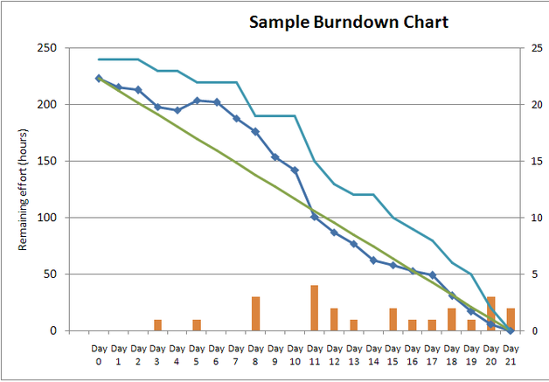
Sprint Burndown Chart
A display of what work has been completed
and what is left to complete
  one for each developer or work item
  updated every day
  (make best guess about hours/points completed each day)
variation: Release burndown chart
  shows overall progress
  updated at end of each sprint

Slide 13
Burndown Example 1
No work being performed

Slide 14
Burndown Example 2
Work being performed, but not fast enough

Slide 15
Burndown Example 3
Work being performed, but too fast!

Slide 16
The Sprint Review
Team presents what it accomplished during the sprint
Typically takes the form of a demo of new features or underlying architecture
Informal
  2-hour prep time rule
  No slides
Whole team participates
Invite the world

Slide 17
Scalability
Typical individual team is 7 ± 2 people
  Scalability comes from teams of teams
Factors in scaling
  Type of application
  Team size
  Team dispersion
  Project duration
Scrum has been used on multiple 500+ person projects

Slide 18






Scaling: Scrum of Scrums

Slide 19
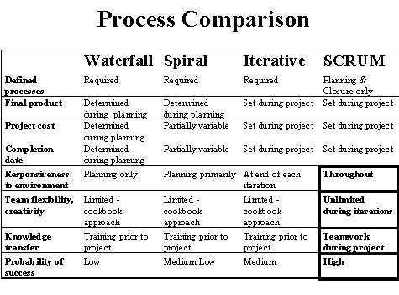
Scrum vs. Other Models

Slide 20
Project Pre initiation & Initiation
Determining roles
Deciding what functionality will be delivered as part of each release.
How many sprints will be required to complete a release
How many releases of software to deliver, similar to dividing the project into several smaller projects.
Project charter, stake holder register, kick off meetings would still be created as part of initiation, just as they were in the first version

Slide 21
Planning
Instead of creating:
Team contract,
WBS,
Gantt Chart
List of prioritization risk for the whole project.
The team would follow scrum method.

Slide 22
Executing
The team would complete tasks each day as it would in the first version of this case
But by using an agile approach, the team would produce several iterations of a potentially shippable product.
For ex; at the end of first sprint, JWD consulting would have some functionality available on its new project management intranet site.

Slide 23
Monitoring & Controlling
Daily scrum-
includes a brief discussion of any issues and blockers the team is facing.
They are held each morning to plan and communicate work for the day and discuss any issues, risks, or blockers
Sprint review

Slide 24
Closure
After the sprint review, the scrum master leads a sprint retrospective.
This meeting is lead by scrum master.
This approach allows the organization to work together quickly to address changing business needs.

Slide 25
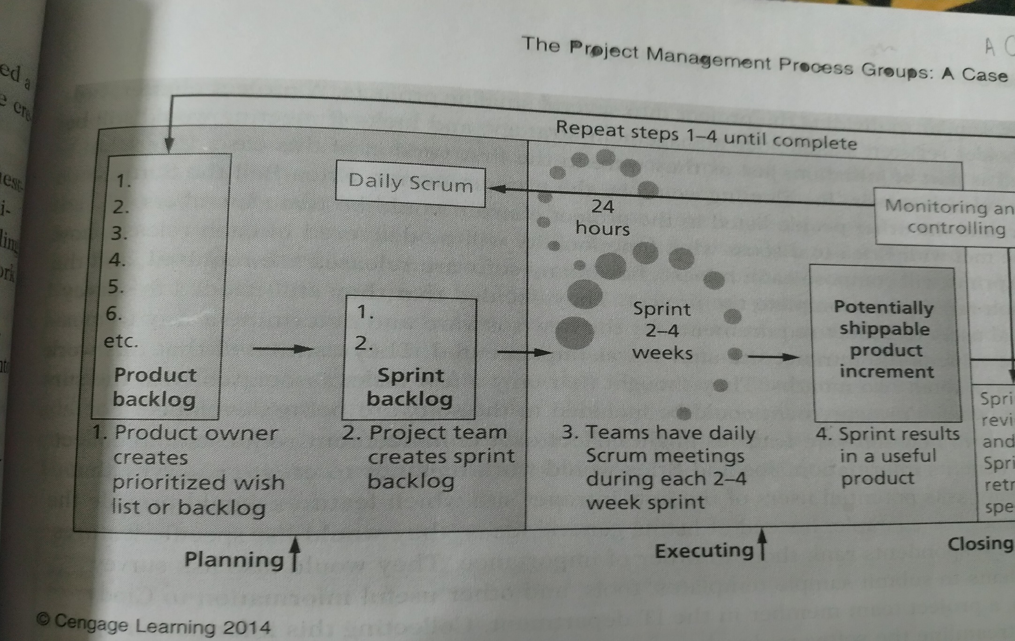

Slide 26
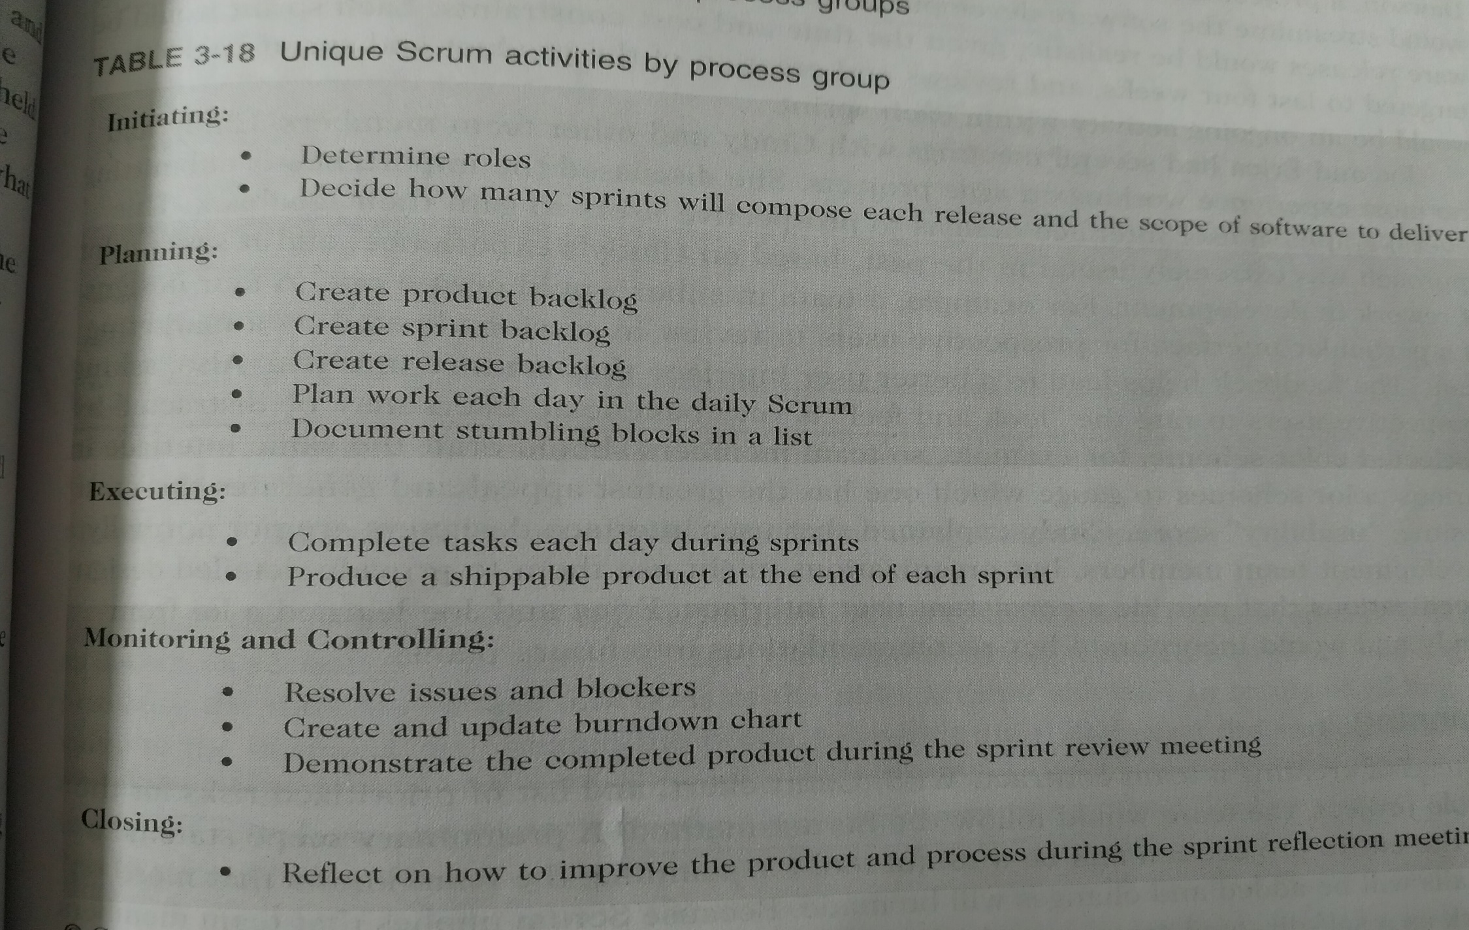

Slide 27
Chapter Summary
The JWD consulting case study demonstrate how one organization managed an IT project from start to finish. This case provides several samples of outputs produced like
Business case,
Stake holder register,
Project charter,
Kickoff meetings,
Team contract,
Work breakdown structure,
Gantt chart,
List of prioritized risks,
Progress report,
Lesson learned report,
Final project report.
The second version of the same case illustrate how to use scrum , the leading agile approach, to manage the project.

