Slide 1
Lecture 19 & 20
Using a Weighted Scoring Model
Implementing a Balanced Scorecard
Developing a Project Charter
Developing a Project Management Plan
Project Management Plan Contents
Using Guidelines to Create Project Management Plans
Directing and Managing Project Work
Coordinating Planning and Execution
Providing Strong Leadership and a Supportive Culture
Capitalizing on Product
Business, and Application Area Knowledge
Project Execution Tools and Techniques
Monitoring and Controlling Project Work
Performing Integrated Change Control
Change Control on IT Projects, Change Control System,
Closing Projects or Phases
Using Software to Assist in Project Integration Management
Chapter Summary
Reading material:
Sch-chap pg. 153- 175

Slide 2
Weighted Scoring Model
A weighted scoring model is a tool that provides a systematic process for selecting projects based on many criteria
Identify criteria important to the project selection process
Assign weights (percentages) to each criterion so they add up to 100%
Assign scores to each criterion for each project
Multiply the scores by the weights and get the total weighted scores
The higher the weighted score, the better

Slide 3
Sample Weighted Scoring Model for Project Selection

Slide 4
Implementing a Balanced Scorecard
Drs. Robert Kaplan and David Norton developed this approach to help select and manage projects that align with business strategy
A balanced scorecard:
Is a methodology that converts an organization’s value drivers, such as customer service, innovation, operational efficiency, and financial performance, to a series of defined metrics

Slide 5
Balanced Scorecard Example

Slide 6
Analytic Hierarchy Process (AHP)
AHP is a Multicriteria Decision-Making Theory (MCDM) that allows one to simultaneously consider both qualitative and quantitative factors to rank-order alternatives.

Slide 7
Project Charters
After deciding what project to work on, it is important to let the rest of the organization know
A project charter is a document that formally recognizes the existence of a project and provides direction on the project’s objectives and management
Key project stakeholders should sign a project charter to acknowledge agreement on the need and intent of the project; a signed charter is a key output of project integration management

Slide 8
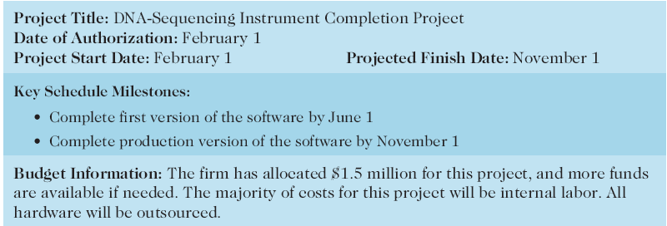
Project Charter for the DNA-Sequencing Instrument Completion Project

Slide 10
Project Management Plans
A project management plan is a document used to coordinate all project planning documents and help guide a project’s execution and control
Plans created in the other knowledge areas are subsidiary parts of the overall project management plan

Slide 11
Common Elements of a Project Management Plan
Introduction or overview of the project
Description of how the project is organized
Management and technical processes used on the project
Work to be done, schedule, and budget information

Slide 12
Sample Contents for a Software Project Management Plan (SPMP)

Slide 13
Project Execution
Project execution involves managing and performing the work described in the project management plan
The majority of time and money is usually spent on execution
The application area of the project directly affects project execution because the products of the project are produced during execution

Slide 14
Coordinating Planning and Execution
Project planning and execution are intertwined and inseparable activities
Those who will do the work should help to plan the work
Project managers must solicit input from the team to develop realistic plans

Slide 15
Providing Leadership and a Supportive Culture
Project managers must lead by example to demonstrate the importance of creating and then following good project plans
Organizational culture can help project execution by:
Providing guidelines and templates
Tracking performance based on plans
Project managers may still need to break the rules to meet project goals, and senior managers must support those actions

Slide 16
Important Skills for Project Execution
General management skills like leadership, communication, and political skills
Product, business, and application area skills and knowledge
Use of specialized tools and techniques

Slide 17
Project Execution Tools and Techniques
Expert judgment: experts can help project managers and their teams make many decisions related to project execution
Project management information systems: there are hundreds of project management software products available on the market today, and many organizations are moving toward powerful enterprise project management systems that are accessible via the Internet

Slide 18
Monitoring and Controlling Project Work
Changes are inevitable on most projects, so it’s important to develop and follow a process to monitor and control changes
Monitoring project work includes collecting, measuring, and disseminating performance information
A baseline is the approved project management plan plus approved changes

Slide 19
Integrated Change Control
Three main objectives are:
Influencing the factors that create changes to ensure that changes are beneficial
Determining that a change has occurred
Managing actual changes as they occur

Slide 20
Change Control on Information Technology Projects
Former view: the project team should strive to do exactly what was planned on time and within budget
Problem: stakeholders rarely agreed up-front on the project scope, and time and cost estimates were inaccurate
Modern view: project management is a process of constant communication and negotiation
Solution: changes are often beneficial, and the project team should plan for them

Slide 21
Change Control System
A formal, documented process that describes when and how official project documents and work may be changed
Describes who is authorized to make changes and how to make them

Slide 22
Change Control Board (CCB)
A formal group of people responsible for approving or rejecting changes on a project
CCBs provide guidelines for preparing change requests, evaluate change requests, and manage the implementation of approved changes
Includes stakeholders from the entire organization

Slide 23
Making Timely Changes
Some CCBs only meet occasionally, so it may take too long for changes to occur
Some organizations have policies in place for time-sensitive changes
“48-hour policy” allows project team members to make decisions; then they have 48 hours to reverse the decision pending senior management approval
Delegate changes to the lowest level possible, but keep everyone informed of changes

Slide 24
Configuration Management
Ensures that the descriptions of the project’s products are correct and complete
Involves identifying and controlling the functional and physical design characteristics of products and their support documentation
Configuration management specialists identify and document configuration requirements, control changes, record and report changes, and audit the products to verify conformance to requirements

Slide 25
Suggestions for Performing Integrated Change Control

Slide 26
Closing Projects and Phases
To close a project or phase, you must finalize all activities and transfer the completed or cancelled work to the appropriate people
Main outputs include:
Final product, service, or result transition
Organizational process asset updates

Slide 27
Using Software to Assist in Project Integration Management
Several types of software can be used to assist in project integration management
Documents can be created with word processing software
Presentations are created with presentation software
Tracking can be done with spreadsheets or databases
Communication software like e-mail and Web authoring tools facilitate communications
Project management software can pull everything together and show detailed and summarized information
Business Service Management (BSM) tools track the execution of business process flows

Slide 28
Chapter Summary
Project integration management involves coordinating all of the other knowledge areas throughout a project’s life cycle
Main processes include:
Develop project charter
Develop project management plan
Direct and manage project execution
Monitor and control project work
Perform integrated change control
Close the project or phase

