Slide 1
Chapter # 5
Project Scope Management
Reading Material: Sch chap 5 pg 187-203

Slide 2
Lecture 21
What Is Project Scope Management?
Planning Scope Management
Collecting Requirements
Defining Scope
Creating the Work Breakdown Structure
Approaches to Developing Work Breakdown Structures
Using Guidelines

Slide 3
Learning Objectives
Understand the importance of good project scope management
Discuss methods for collecting and documenting requirements in order to meet stakeholder needs and expectations
Explain the scope definition process and describe the contents of a project scope statement
Discuss the process for creating a work breakdown structure using the analogy, top-down, bottom-up, and mind-mapping approaches

Slide 4
Learning Objectives (continued)
Explain the importance of verifying scope and how it relates to defining and controlling scope
Understand the importance of controlling scope and approaches for preventing scope-related problems on information technology projects
Describe how software can assist in project scope management

Slide 5
What is Project Scope Management?
Scope refers to all the work involved in creating the products of the project and the processes used to create them
A deliverable is a product produced as part of a project, such as hardware or software, planning documents, or meeting minutes
Product related deliverables (e.g., software)
Process related deliverables (e.g., meeting minutes)
Project scope management includes the processes involved in defining and controlling what is or is not included in a project

Slide 6
Project Scope Management Processes
Collecting requirements: defining and documenting the features and functions of the products produced during the project as well as the processes used for creating them
Defining scope: reviewing the project charter, requirements documents, and organizational process assets to create a scope statement
Creating the WBS: subdividing the major project deliverables into smaller, more manageable components
Verifying scope: formalizing acceptance of the project deliverables
Controlling scope: controlling changes to project scope throughout the life of the project

Slide 7
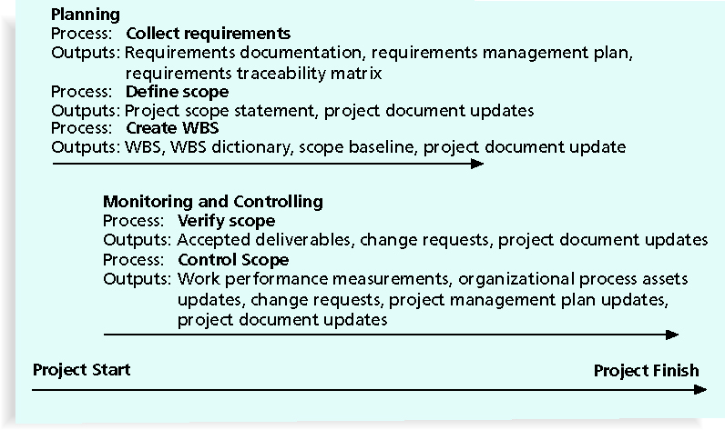
Project Scope Management Summary

Slide 8
Collecting Requirements
A requirement is “a condition or capability that must be met or possessed by a system, product, service, result, or component to satisfy a contract, standard, specification, or other formal document” (PMBOK® Guide, 2008)
For some IT projects, it is helpful to divide requirements development into categories called elicitation, analysis, specification, and validation
It is important to use an iterative approach to defining requirements since they are often unclear early in a project

Slide 9
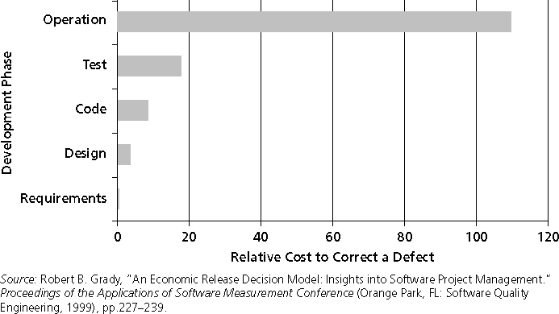
Relative Cost to Correct a Software Requirement Defect

Slide 10
Methods for Collecting Requirements
Interviewing
Focus groups and facilitated workshops
Using group creativity and decision-making techniques
Questionnaires and surveys
Observation
Prototyping
Software tools

Slide 11
Affinity Diagram
Affinity diagram is a tool that gathers a large amount of verbal/written ideas during a brainstorming process and groups them based on the natural relationship among the ideas.
It can be used in techniques that gather requirements through group sessions (e.g., Joint Application Development, and Accelerated Requirements Elicitations)

Slide 12
What Went Right?
Genesys Telecommunications Laboratories uses Accept software, a product planning and innovation management application and winner of the Excellence in Product Management Award from 2006–2008
Accept helps them instill a consistent, repeatable, and predictable process for new product definition and development
They can define what information comprises a requirement and enforce discipline around that process

Slide 13
Documenting Requirements
Requirements documents are often generated by software and include text, images, diagrams, videos, and other media; they are often broken down into different categories such as functional, service, performance, quality, training requirements, and so on
A requirements management plan describes how project requirements will be analyzed, documented, and managed
A requirements traceability matrix (RTM) is a table that lists requirements, various attributes of each requirement, and the status of the requirements to ensure that all requirements are addressed

Slide 14
Sample Requirements Traceability Matrix

Slide 15
Defining Scope
Key inputs for preparing the project scope statement include the project charter, requirements documentation, and organizational process assets such as policies and procedures related to scope statements as well as project files and lessons learned from previous, similar projects
As time progresses, the scope of a project should become more clear and specific

Slide 16
Further Defining Project Scope

