Slide 1
Lecture 23 & 24
The Analogy Approach
The Top-Down and Bottom-Up Approaches
Mind Mapping
The WBS Dictionary
Advice for Creating a WBS and WBS Dictionary
Validating Scope
Controlling Scope
Suggestions for Improving User Input
Suggestions for Reducing Incomplete and Changing Requirements
Using Software to Assist in Project Scope Management

Slide 2
Approaches to Developing WBSs (cont….)
Using guidelines: some organizations, like the DOD, provide guidelines for preparing WBSs
The analogy approach: review WBSs of similar projects and tailor to your project
The top-down approach: start with the largest items of the project and break them down
The bottom-up approach: start with the specific tasks and roll them up
Mind-mapping approach: mind mapping is a technique that uses branches radiating out from a core idea to structure thoughts and ideas

Slide 3
2. Analogy
▪▪ Base WBS upon that of a “similar” project
▪▪ Use a template
▪▪ Analogy also can be estimation basis
▪▪ Advantages
Based on past actual experience
▪▪ Disadvantages
Needs comparable project

Slide 4
3. Top-down
Start at highest level
Systematically develop increasing level of detail
Best if
The problem is well understood
Technology and methodology are not new
This is similar to an earlier project or problem
But is also applied in majority of situations
Advantages
Quick
Can be done when only part of the requirements is understood
Disadvantages
May lack important details specific to the project that have never occurred in earlier projects

Slide 5
Top-down contd…
Top & middle managers determine overall project schedule &/or cost
Lower level managers are expected to breakdown schedule/budget estimates into specific activities (WBS)

Slide 6
4. Bottom-up
Start at lowest level tasks
Aggregate into summaries and higher levels
Schedules & budgets are constructed from WBS
Starts with people who will be doing the work
Schedules & budgets are the aggregate of detailed activities & costs
Disadvantages
Time consuming
Needs more requirements complete
Advantages
Detailed

Slide 7
5. Mind mapping
This is a very useful technique used by most Project Specialists and especially for the Project Managers.
In this approach, we need to write the task in a non-linear, branching format and then create the WBS structure.
This adopts a technique to branch out a main idea into thoughts and ancillary ideas.
It facilitates collection, organization and visual representation of thoughts to facilitate decision-making and project planning, using mind-mapping software
There are many mind-mapping tools available in the market.

Slide 8
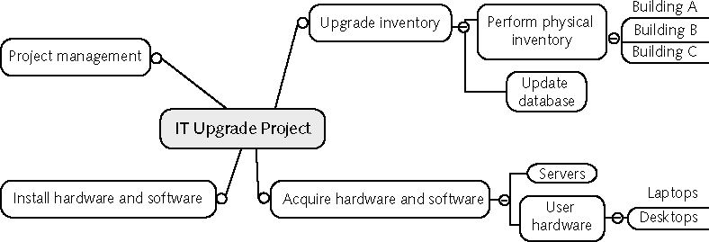
Sample Mind-Mapping Approach for Creating a WBS

Slide 9
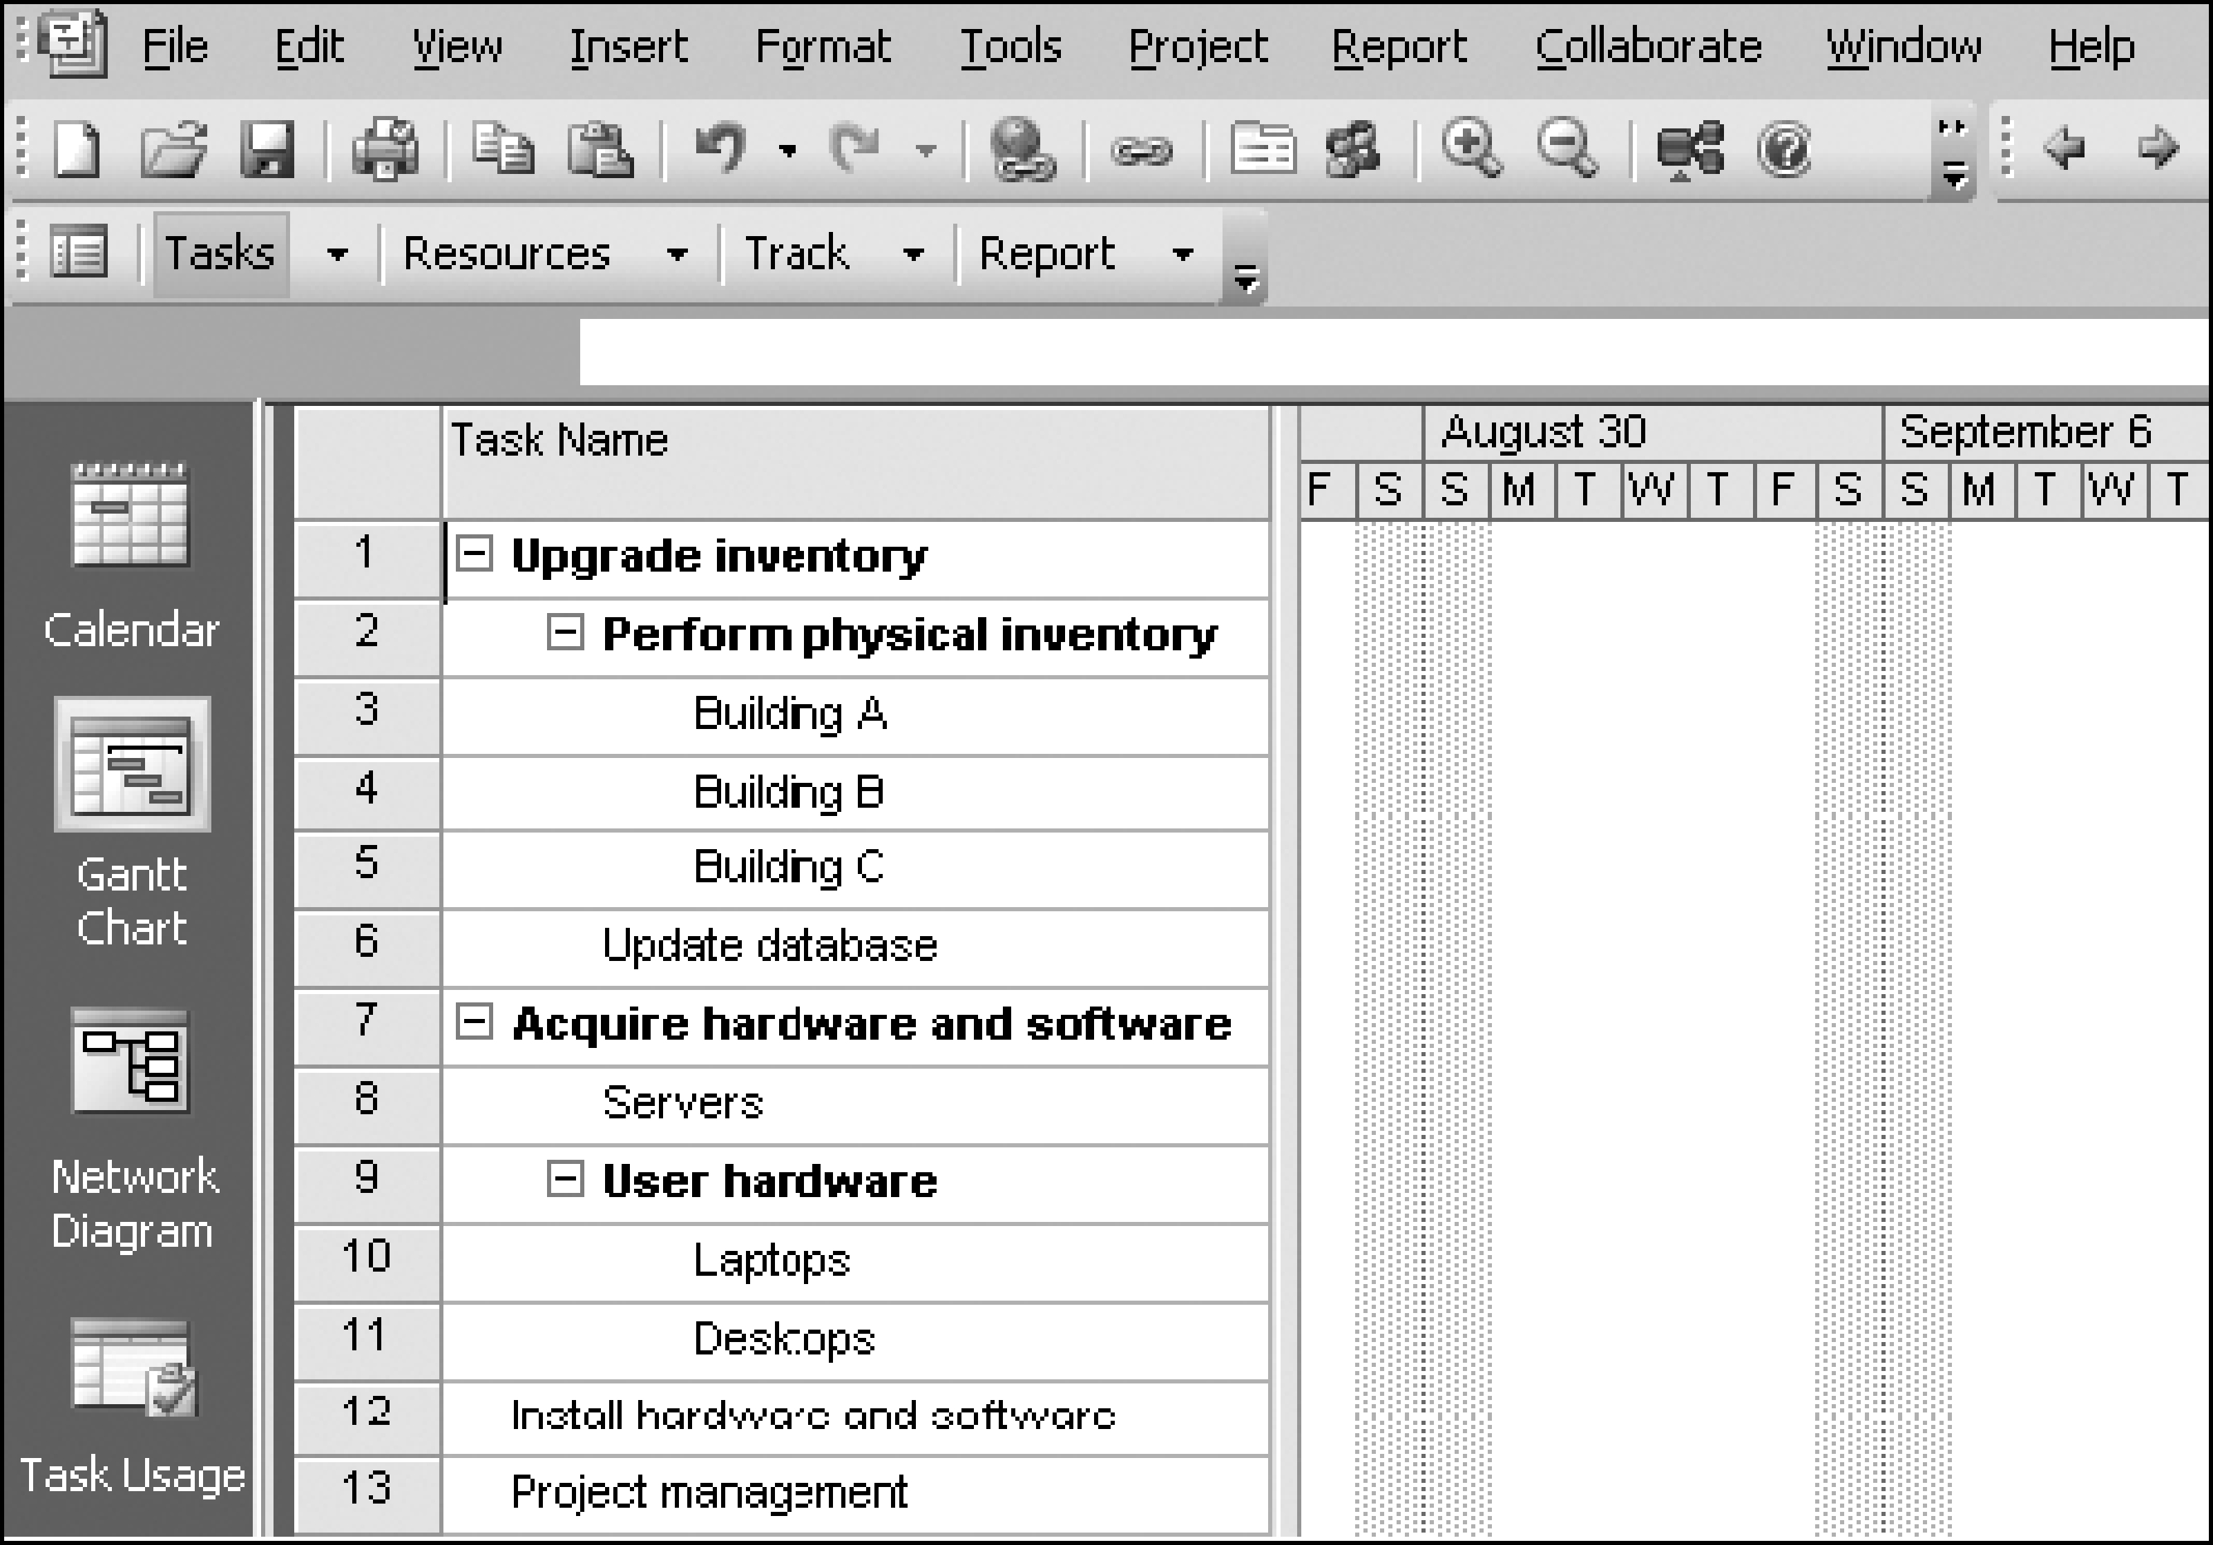
Project 2007 File with WBS Generated from a Mind Map

Slide 10
Important Points for WBS
Ensure that the WBS is the sum of all the work involved in your project
While the WBS list is for an individual, multiple people can work on this
The Work break down structure must be consistent in the way work is going to be performed
Project team members need to be included in the WBS so that things run smoothly
Each WBS must be documented in a WBS dictionary to ensure the accurate understanding of the scope of the project.

Slide 11
Process of WBS
Finally, using these inputs and tools you will create the following outputs:
Work Breakdown Structure
WBS Dictionary
Scope Baseline
Project Scope Statement (updates)
Project Scope Management Plan (updates)
Requested Changes - (PMBOK Guide)

Slide 12
The WBS Dictionary and Scope Baseline
Many WBS tasks are vague and must be explained more so people know what to do and can estimate how long it will take and what it will cost to do the work
A WBS dictionary is a document that describes detailed information about each WBS item
The approved project scope statement and its WBS and WBS dictionary form the scope baseline, which is used to measure performance in meeting project scope goals

Slide 13
Advice for Creating a WBS and WBS Dictionary
A unit of work should appear at only one place in the WBS
The work content of a WBS item is the sum of the WBS items below it
A WBS item is the responsibility of only one individual, even though many people may be working on it
The WBS must be consistent with the way in which work is actually going to be performed; it should serve the project team first and other purposes only if practical

Slide 14
Advice for Creating a WBS and WBS Dictionary (continued)
Project team members should be involved in developing the WBS to ensure consistency and buy-in
Each WBS item must be documented in a WBS dictionary to ensure accurate understanding of the scope of work included and not included in that item
The WBS must be a flexible tool to accommodate inevitable changes while properly maintaining control of the work content in the project according to the scope statement

Slide 15
What Went Wrong?
A project scope that is too broad and grandiose can cause severe problems
In 2001, McDonald’s fast-food chain initiated a project to create an intranet that would connect its headquarters with all of its restaurants to provide detailed operational information in real time; after spending $170 million on consultants and initial implementation planning, McDonald’s realized that the project was too much to handle and terminated it

Slide 16
Verifying Scope
It is very difficult to create a good scope statement and WBS for a project
It is even more difficult to verify project scope and minimize scope changes
Scope verification involves formal acceptance of the completed project scope by the stakeholders
Acceptance is often achieved by a customer inspection and then sign-off on key deliverables

Slide 17
Controlling Scope
Scope control involves controlling changes to the project scope
Goals of scope control are to:
Influence the factors that cause scope changes
Assure changes are processed according to procedures developed as part of integrated change control
Manage changes when they occur
Variance is the difference between planned and actual performance

Slide 18
Best Practices for Avoiding Scope Problems
1. Keep the scope realistic. Don’t make projects so large that they can’t be completed. Break large projects down into a series of smaller ones.
2. Involve users in project scope management. Assign key users to the project team and give them ownership of requirements definition and scope verification.
3. Use off-the-shelf hardware and software whenever possible. Many IT people enjoy using the latest and greatest technology, but business needs, not technology trends, must take priority.
4. Follow good project management processes. As described in this chapter and others, there are well-defined processes for managing project scope and others aspects of projects.

Slide 19
Suggestions for Improving User Input
Develop a good project selection process and insist that sponsors are from the user organization
Have users on the project team in important roles
Have regular meetings with defined agendas, and have users sign off on key deliverables presented at meetings
Deliver something to users and sponsors on a regular basis
Don’t promise to deliver when you know you can’t
Co-locate users with developers

Slide 20
Suggestions for Reducing Incomplete and Changing Requirements
Develop and follow a requirements management process
Use techniques such as prototyping, use case modeling, and JAD to get more user involvement
Put requirements in writing and keep them current
Create a requirements management database for documenting and controlling requirements

Slide 21
Suggestions for Reducing Incomplete and Changing Requirements (continued)
Provide adequate testing and conduct testing throughout the project life cycle
Review changes from a systems perspective
Emphasize completion dates to help focus on what’s most important
Allocate resources specifically for handling change requests/enhancements like NWA did with ResNet

Slide 22
Using Software to Assist in Project Scope Management
Word-processing software helps create several scope-related documents
Spreadsheets help to perform financial calculations and weighted scoring models and to develop charts and graphs
Communication software like e-mail and the Web help clarify and communicate scope information
Project management software helps in creating a WBS, the basis for tasks on a Gantt chart
Specialized software is available to assist in project scope management

Slide 23
Chapter Summary
Project scope management includes the processes required to ensure that the project addresses all the work required, and only the work required, to complete the project successfully
Main processes include:
Collect requirements
Define scope
Create WBS
Verify scope
Control scope

