Slide 1
Lecture # 25
Introduction to chapter #6
The Importance of Project Schedules
Individual Work Styles and Cultural Differences Cause Schedule Conflicts
Project Time Management Processes
Planning Schedule Management

Slide 2
Chapter # 6
Project Time Management

Slide 3
Learning Objectives
Understand the importance of project schedules and good project time management
Define activities as the basis for developing project schedules
Describe how project managers use network diagrams and dependencies to assist in activity sequencing
Understand the relationship between estimating resources and project schedules
Explain how various tools and techniques help project managers perform activity duration estimating

Slide 4
Learning Objectives (contd…)
Use a Gantt chart for planning and tracking schedule information, find the critical path for a project, and describe how critical chain scheduling and the Program Evaluation and Review Technique (PERT) affect schedule development
Discuss how reality checks and people issues are involved in controlling and managing changes to the project schedule
Describe how project management software can assist in project time management and review words of caution before using this software

Slide 5
Importance of Project Schedules
Managers often cite delivering projects on time as one of their biggest challenges
Time has the least amount of flexibility; it passes no matter what happens on a project
Schedule issues are the main reason for conflicts on projects, especially during the second half of projects

Slide 6
Individual Work Styles and Cultural Differences Cause Schedule Conflicts
One dimension of the Meyers-Briggs Type Indicator focuses on peoples’ attitudes toward structure and deadline
Some people prefer to follow schedules and meet deadlines while others do not (J vs. P)
Difference cultures and even entire countries have different attitudes about schedules

Slide 7
Media snapshots
In contrast to the 2002 Salt Lake City Winter Olympic Games (see Chapter 4’s Media Snapshot), planning and scheduling was very different for the 2004 Summer Olympic Games held in Athens, Greece
Many articles were written before the opening ceremonies predicting that the facilities would not be ready in time; many people were pleasantly surprised by the amazing opening ceremonies, beautiful new buildings, and state-of-the-art security and transportation systems in Athens
The Greeks even made fun of critics by having construction workers pretend to still be working as the ceremonies began

Slide 8
Project Time Management Processes
Defining activities: identifying the specific activities that the project team members and stakeholders must perform to produce the project deliverables
Sequencing activities: identifying and documenting the relationships between project activities
Estimating activity resources: estimating how many resources a project team should use to perform project activities
Estimating activity durations: estimating the number of work periods that are needed to complete individual activities
Developing the schedule: analyzing activity sequences, activity resource estimates, and activity duration estimates to create the project schedule
Controlling the schedule: controlling and managing changes to the project schedule

Slide 9
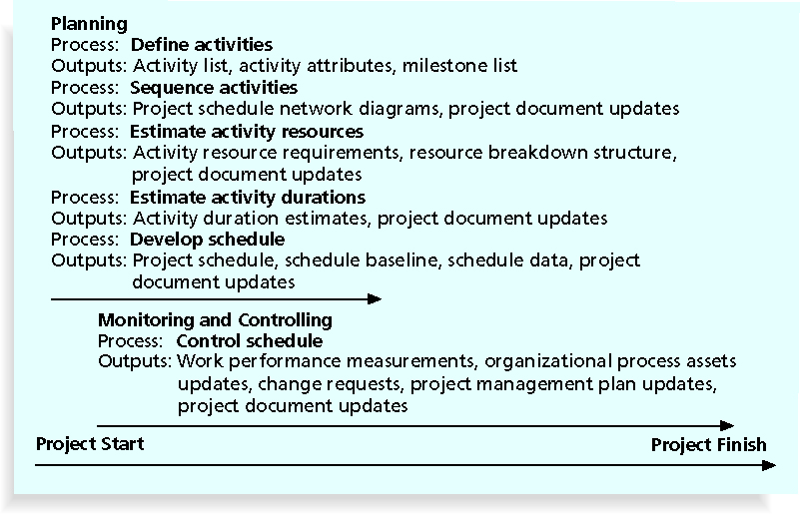
Project Time Management Summary

Slide 10
Defining Activities
An activity or task is an element of work normally found on the work breakdown structure (WBS) that has an expected duration, a cost, and resource requirements
Activity definition involves developing a more detailed WBS and supporting explanations to understand all the work to be done so you can develop realistic cost and duration estimates

Slide 11
Activity Lists and Attributes
An activity list is a tabulation of activities to be included on a project schedule that includes:
The activity name
An activity identifier or number
A brief description of the activity
Activity attributes provide more information such as predecessors, successors, logical relationships, leads and lags, resource requirements, constraints, imposed dates, and assumptions related to the activity

Slide 12
Milestones
A milestone is a significant event that normally has no duration
It often takes several activities and a lot of work to complete a milestone
They’re useful tools for setting schedule goals and monitoring progress
Examples include obtaining customer sign-off on key documents or completion of specific products

