Slide 1
Lecture # 27
Estimating Activity Resources
Estimating Activity Durations
Developing the Schedule

Slide 2
Estimating Activity Resources
Before estimating activity durations, you must have a good idea of the quantity and type of resources that will be assigned to each activity; resources are people, equipment, and materials
Consider important issues in estimating resources
How difficult will it be to do specific activities on this project?
What is the organization’s history in doing similar activities?
Are the required resources available?
A resource breakdown structure is a hierarchical structure that identifies the project’s resources by category and type

Slide 3
Resource Breakdown Structure
The resource breakdown structure (RBS) is a tool within project management.
It is hierarchical listing of resources necessary to complete a project and a resource is everything with a cost that is needed to complete the project.
The use of a resource breakdown structure can provide many advantages to a project, particularly when the project requires a complex array of different resources.
Resource breakdown structures allow managers to keep track of which resources are needed for which phase of a project and which personnel are supposed to work with which resources.
Using one can help ensure that resources are where they are supposed to be during the appropriate phases of a project and that redundant resources are not purchased or used.

Slide 4
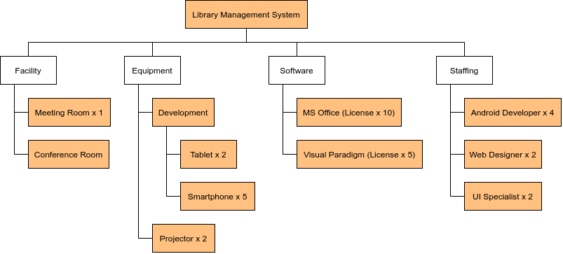
Example of RBS

Slide 5
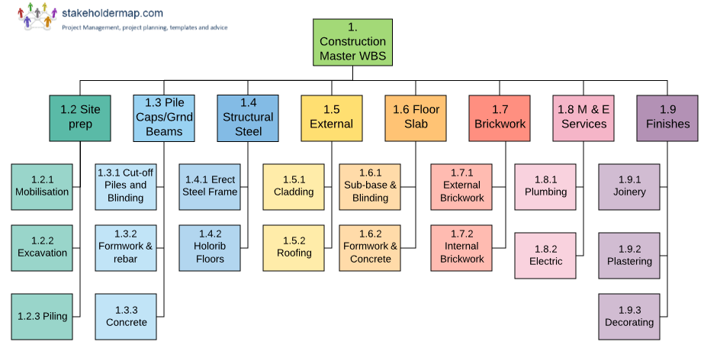
Example of WBS

Slide 6
Difference between WBS & RBS
Work breakdown structure is an important deliverable for any project. Through the WBS, the project manager is in a good position to categorize the work that the team needs to accomplish into small sections that can be managed easily
RBS is considered an important part of efficiency when it comes to project management. Through RBS, the project manager is able to compile a list of resources needed to accomplish a given task in hierarchical order.

Slide 7
Cont….
WBS is that it helps the project manager determine any potential risks that a project might have.
In case there is any branch of the project that has not been clearly defined, it becomes a risk area that has to be addressed.
Such risks are supposed to be tracked properly, and a careful review provided as the project goes on.
In case the project seems like it is falling behind schedule, it is easier for the project manager to refer to the WBS and identify the areas that are struggling, and make the appropriate decision to turn things around.
In contrast, the immediate benefit of RBS, especially the breaking down of resources into sub-groups is to ease the work of management centers. Supervision becomes much easier and a lot of time is saved in the process.

Slide 8
Tools used for RBS
The project managers are instructed to employ or execute an efficient RBS by using these tools. These are as follows:
Activity list
This is a list of all the activities that are key to the completion of the project.
The project manager does not just need a list, they need to get as much information as conceivably possible about lists too.
This information will also include the resources that the activities listed consume.

Slide 9
Tools used for RBS (cont..)
Resource estimation
For each activity to be accomplished in a productive, efficient and more importantly, cost-effective manner
The project manager must estimate the volume, type and variety of resources that are needed.
If these estimates are skewed, it might be impossible to achieve the objectives of the project, or as a whole, the project could fail.

Slide 10
Tools used for RBS (cont..)
Resource calendar
A resource calendar is about the availability of resources over time.
The project manager will need a list of all the resources that are needed to complete the project.
These resources must also be listed based on their availability over the long term.
This information is important for the project manager to ascertain whether the resources needed will be available during a specific time, so the project does not stall.

Slide 11
Tools used for RBS (cont..)
At the moment, RBS is becoming more and more important, with project management software incorporating it into their structure.
If you are using any project management program, you can log in and check the availability of the resources you need, and more importantly how they are classified.
This generally helps the organization in the sense that the project managers are able to view a lot of details from a simple database, about all the resources being used.

Slide 12
Activity Duration Estimating
Duration includes the actual amount of time worked on an activity plus elapsed time
Effort is the number of workdays or work hours required to complete a task
Effort does not normally equal duration
People doing the work should help create estimates, and an expert should review them

Slide 13
Three-Point Estimates
Instead of providing activity estimates as a discrete number, such as four weeks, it’s often helpful to create a three-point estimate
An estimate that includes an optimistic, most likely, and pessimistic estimate, such as three weeks for the optimistic, four weeks for the most likely, and five weeks for the pessimistic estimate
Three-point estimates are needed for PERT and Monte Carlo simulations

Slide 14
Three Point Estimating and Risk Analysis
The key benefit of three point estimating is the way it takes into account project risk. The following procedure is how it works, PMBOK-style. From the very beginning:
The project success factors are determined
Risks which might affect the project success factors are identified
The risks are analyzed and prioritized to determine which are the most important.
The project is divided into tasks (a work breakdown structure).
Each task receives three estimates:
Optimistic. Assuming the risks do not occur.
Most likely. Assuming the risk occurrence level that is most likely to occur. Similar to other estimate types.
Pessimistic. Assuming that the risks occur.

Slide 15
Three Point Estimating and Risk Analysis (contd..)
The Three Point Estimating procedure is used to determine the final estimate for each task.
There are many situations where a risk results in a skewed distribution. For example, a risk might result in a cost escalation but no corresponding cost reduction if it doesn’t occur.
This would make the Pessimistic estimate farther away from the Most Likely value than the Optimistic one (that is, the Most Likely value is not directly in the middle) and result in a skewed distribution.

Slide 16
Other Task Level Estimating Techniques
Three point estimating is one out of three estimating methods which are applied at the individual task level. The other two are:
Parametric Estimating: Estimation of a task using a unit rate (parametric rate). For example, house construction costs $120 per square foot.
Analogous Estimating: Estimation of a task using a previous, similar project. For example, the flooring in the previous house cost $10,000 therefore this one should cost $12,000.
These methods apply to individual tasks and are thus contained within the PMBOK’s Estimate Costs process.

Slide 17
Overall Project Level Estimating Techniques
Do not confuse the three task-level estimation techniques, above, with the following two project-level estimation techniques.
The PMBOK contains a separate process for rolling up the costs into the overall project, called Determine Budget, and it contains the following two procedures:
Top Down Estimating: This refers to determining the overall project estimate first, and then apportioning it into individual tasks.
For example, the previous house cost $240,000 to build (analogous), therefore this one should cost $260,000, which will be apportioned among the tasks. Usually, this technique requires task level estimation as well, to determine the correct ratios to use for apportioning.
Bottom Up Estimating: Opposite of Top Down. This refers to determining the individual task estimates first, then rolling them up into an overall project estimate. Bottom Up is the norm in most project management applications.
The project manager must estimate on an individual task level and determine the project budget by summing (aggregating) the individual tasks.

Slide 18
Developing the Schedule
Uses results of the other time management processes to determine the start and end date of the project
Ultimate goal is to create a realistic project schedule that provides a basis for monitoring project progress for the time dimension of the project
Important tools and techniques include Gantt charts, critical path analysis, and critical chain scheduling, and PERT analysis

