Slide 2
Lecture # 28
Gantt Charts
Adding Milestones to Gantt Charts
Using Tracking Gantt Charts to Compare Planned and Actual Dates

Slide 3
Gantt Charts
Gantt charts provide a standard format for displaying project schedule information by listing project activities and their corresponding start and finish dates in a calendar format
Symbols include:
Black diamonds: milestones
Thick black bars: summary tasks
Lighter horizontal bars: durations of tasks
Arrows: dependencies between tasks

Slide 4
Gantt Chart for Project X

Slide 5
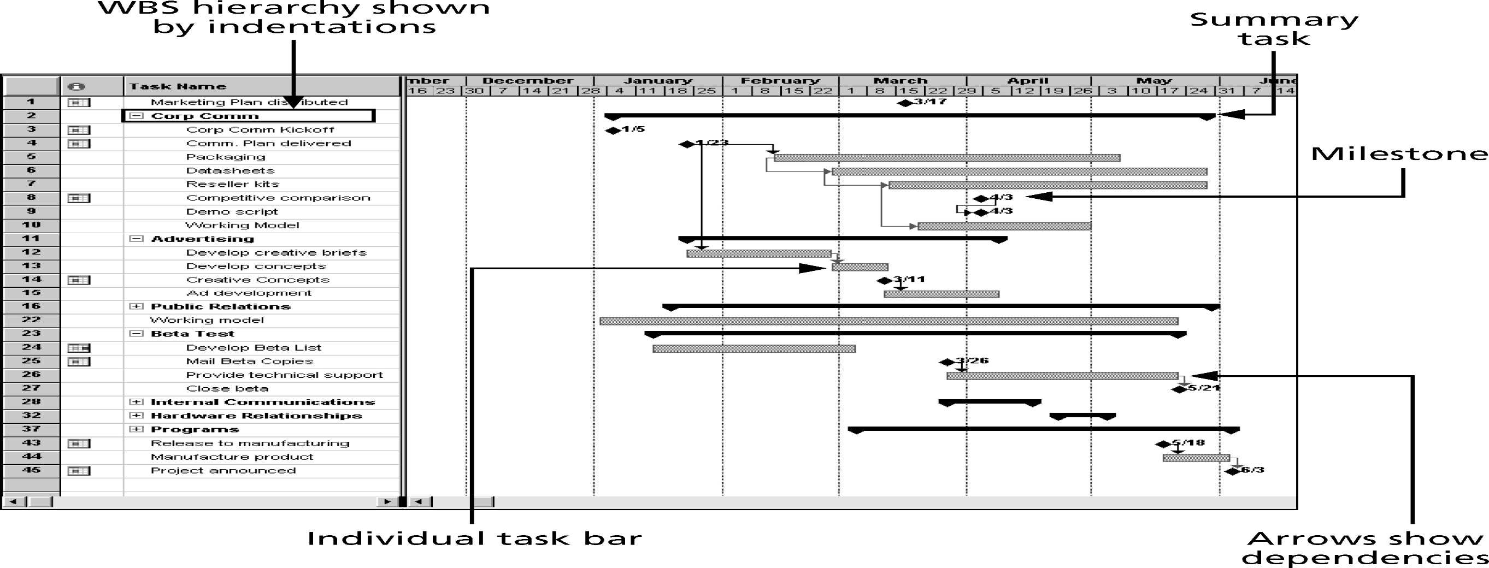
Gantt Chart for Software Launch Project

Slide 6
Adding Milestones to Gantt Charts
Many people like to focus on meeting milestones, especially for large projects
Milestones emphasize important events or accomplishments on projects
Normally create milestone by entering tasks with a zero duration, or you can mark any task as a milestone

Slide 7
SMART Criteria
Milestones should be:
Specific
Measurable
Assignable
Realistic
Time-framed

Slide 8
Best Practice
Schedule risk is inherent in the development of complex systems. Luc Richard, the founder of www.projectmangler.com, suggests that project managers can reduce schedule risk through project milestones, a best practice that involves identifying and tracking significant points or achievements in the project. The five key points of using project milestones include the following:
1. Define milestones early in the project and include them in the Gantt chart to provide a visual guide.
2. Keep milestones small and frequent.
3. The set of milestones must be all-encompassing.
4. Each milestone must be binary, meaning it is either complete or incomplete.
5. Carefully monitor the critical path.

Slide 9
Sample Tracking Gantt Chart

