Slide 1
Lecture 9 & 10
Organizational Structures
Organizational Culture,
Stakeholder Management
The Importance of Top Management Commitment,
The Need for Organizational Commitment to Information Technology
The Need for Organizational Standards
Reading Material: Sch-chap 2: pg.49-56

Slide 2
Organizational Structures
3 basic organization structures:
Functional: functional managers report to the CEO
Project: program managers report to the CEO
Matrix: middle ground between functional and project structures; personnel often report to two or more bosses; structure can be weak, balanced, or strong matrix

Slide 3
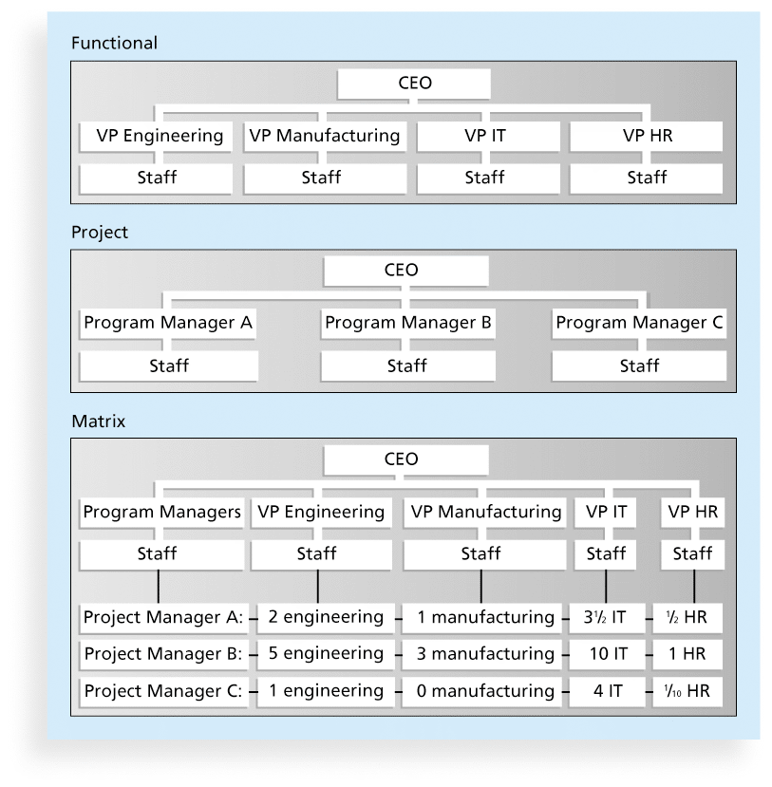
Functional, Project, and Matrix Organizational Structures

Slide 4
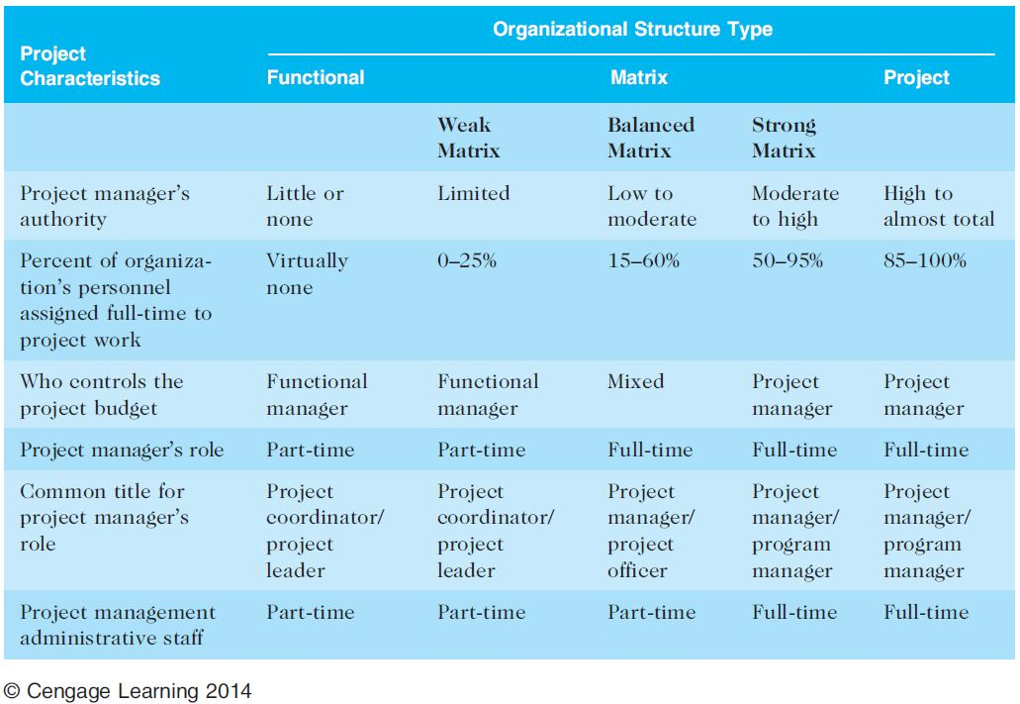
Organizational Structure Influences on Projects

Slide 5
Organizational Culture
Organizational culture is a set of shared assumptions, values, and behaviors that characterize the functioning of an organization
Many experts believe the underlying causes of many companies’ problems are not the structure or staff, but the culture

Slide 6
Ten Characteristics of Organizational Culture
Member identity*
Group emphasis*
People focus
Unit integration*
Control
Risk tolerance*
Reward criteria*
Conflict tolerance*
Means-ends orientation
Open-systems focus*
*Project work is most successful in an organizational culture where these items are strong/high and other items are balanced.

Slide 7
Stakeholder Management
Project managers must take time to identify, understand, and manage relationships with all project stakeholders
Using the four frames of organizations can help meet stakeholder needs and expectations
Senior executives/top management are very important stakeholders

Slide 8
Media Snapshot
The media have often reported on mismanaged IT projects. A classic example and popular case study is the baggage handling system at Denver International Airport (DIA).
The system was supposed to reduce flight delays, shorten waiting times at luggage carousels, and save money, but instead it caused huge problems.
One important reason for this famous project disaster was the failure to recognize the project’s complexity.

Slide 9
The Importance of Top Management Commitment
People in top management positions are key stakeholders in projects
A very important factor in helping project managers successfully lead projects is the level of commitment and support they receive from top management
Without top management commitment, many projects will fail.
Some projects have a senior manager called a champion who acts as a key proponent for a project.

Slide 10
How Top Management Can Help Project Managers
Providing adequate resources
Approving unique project needs in a timely manner
Getting cooperation from other parts of the organization
Mentoring and coaching on leadership issues

Slide 11
The Need for Organizational Commitment to Information Technology The Need for Organizational Standards
IT is integral to business & have created many positions.
Lack of standards & guidelines

