Slide 1
Phases of Project & life cycle
Prepared by:
Syed ShahRukh Haider

Slide 2
Project Management Life Cycle
Project Management Life Cycle comprises four phases...
Initiation: involves starting up the project, by documenting a business case, feasibility study, terms of reference, appointing the team and setting up a Project Office.
Planning: involves setting out the roadmap for the project by creating the following plans: project plan, resource plan, financial plan, quality plan, acceptance plan and communications plan.
Execution: involves building the deliverables and controlling the project delivery, scope, costs, quality, risks and issues.
Closure: involves winding-down the project by releasing staff, handing over deliverables to the customer and completing a post implementation review

Slide 3
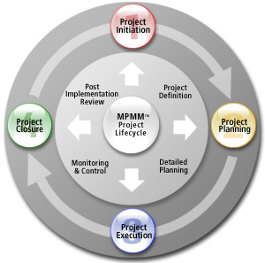
THE FOUR PHASES OF A PROJECT

Slide 4
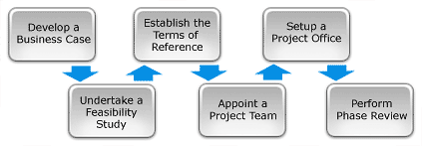
Project Initiation
It is the first phase in the Project Life Cycle and essentially involves starting up the project. You initiate a project by defining its purpose and scope, the justification for initiating it and the solution to be implemented. You will also need to recruit a suitably skilled project team, set up a Project Office and perform an end of Phase Review. The Project Initiation phase involves the following six key steps:

Slide 5
Project Planning
After defining the project and appointing the project team, you're ready to enter the detailed Project Planning phase. This involves creating a suite of planning documents to help guide the team throughout the project delivery. The Planning Phase involves completing the following 10 key steps:

Slide 6
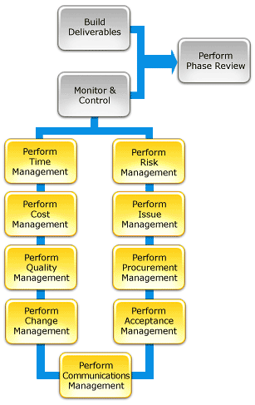
Project Execution
With a clear definition of the project and a suite of detailed project plans, you are now ready to enter the Execution phase of the project.
This is the phase in which the deliverables are physically built and presented to the customer for acceptance.
While each deliverable is being constructed, a suite of management processes are undertaken to monitor and control the deliverables being output by the project.
These processes include managing time, cost, quality, change, risks, issues, suppliers, customers and communication.
Once all the deliverables have been produced and the customer has accepted the final solution, the project is ready for closure.

Slide 7
Project Closure
It involves releasing the final deliverables to the customer, handing over project documentation to the business, terminating supplier contracts, releasing project resources and communicating project closure to all stakeholders. The last remaining step is to undertake a Post Implementation Review to identify the level of project success and note any lessons learned for future projects.

Slide 8
Initiation

Slide 9
Planning

Slide 10
Execution

Slide 11
Close Out

Slide 12
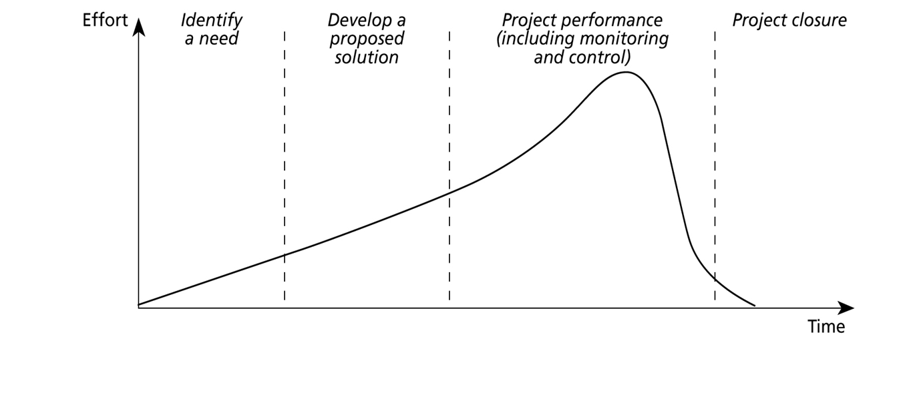
Project Phases

Slide 13
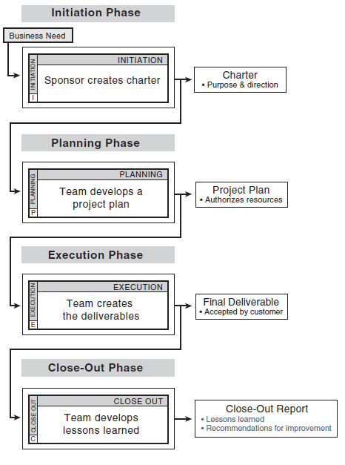
Process flow chart of project phases

